Slide 1
IST 363 Advanced Front End Web Design
CSS Bootstrap Day 2

Slide 2
What are we covering today?
Pro Tip for your Assignment: Sharing files in Github
Bootstrap Icons
Customizing Bootstrap
Bootstrap Components

Slide 3
Sharing a File in Github

Slide 4
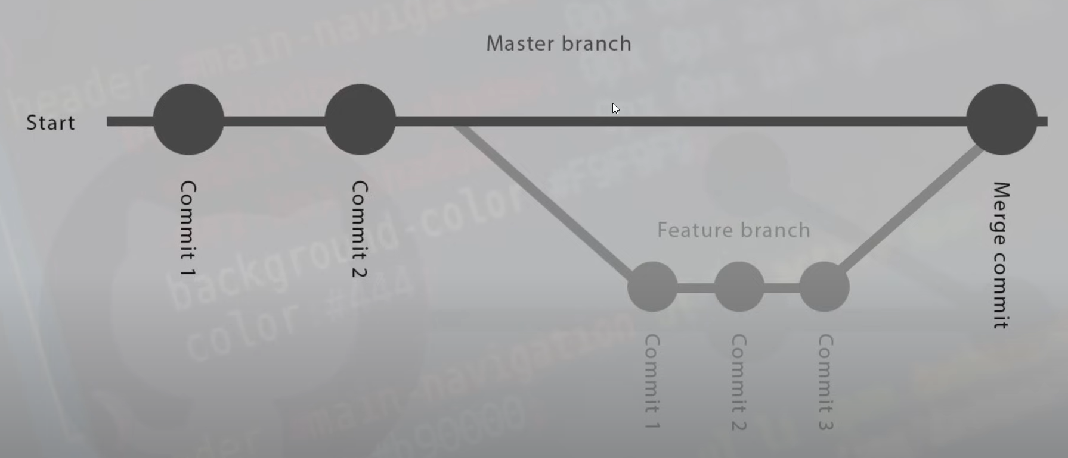
Branches and Merging

Slide 5
Customizing Bootstrap

Slide 6
Custom CSS
Could you add custom CSS to override Bootstrap files? Yes! But I don’t recommend it.
Instead use custom Sass variables. It works better and won’t be overwritten when Bootstrap updates!

Slide 7
Download
We need some more of the Bootstrap files to do this so download:
https://getbootstrap.com/docs/5.3/getting-started/download/ Compiled CSS and JS

Slide 8
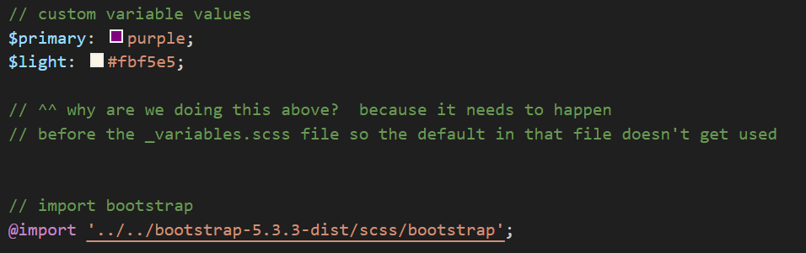
Make a custom SCSS page

Slide 9

Run the Preprossesor/Compiler and Link

Slide 10
Custom Colors
Create a new page for your activities.
Put Hello World in an h1 tag and use the bootstrap warning color for it.
Customize the warning color in the SCSS file and compile to CSS that you include in this page.
ACTIVITY

Slide 11
Icons

Slide 12
Install and Go
I’m using the CDN Link for this:
<link rel="stylesheet" href="https://cdn.jsdelivr.net/npm/bootstrap-icons@1.3.0/font/bootstrap-icons.css">
Then go to: https://icons.getbootstrap.com/
To get code like this:
<i class="bi bi-star"></i>

Slide 13

Icons
Add the following icon to your page.
ACTIVITY

Slide 14
Components

Slide 15
What are Bootstrap Components?
They help you rapidly develop functionality that is common across the web.

Slide 16
Components
List three components and give me a scenario where you’d use them.
You can write all of this in a comment in your html and copy and paste your HTML page into participation06.
ACTIVITY

Slide 17
The End!

